Slide 1
Methods of hatching eggs
Two methods-natural method and artificial method
Natural method of incubation:
Brooding hen:

Slide 2
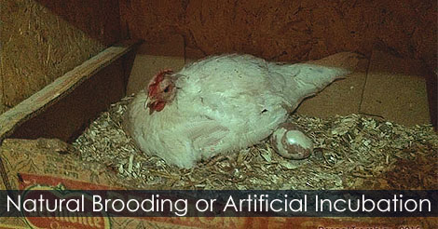

Slide 3
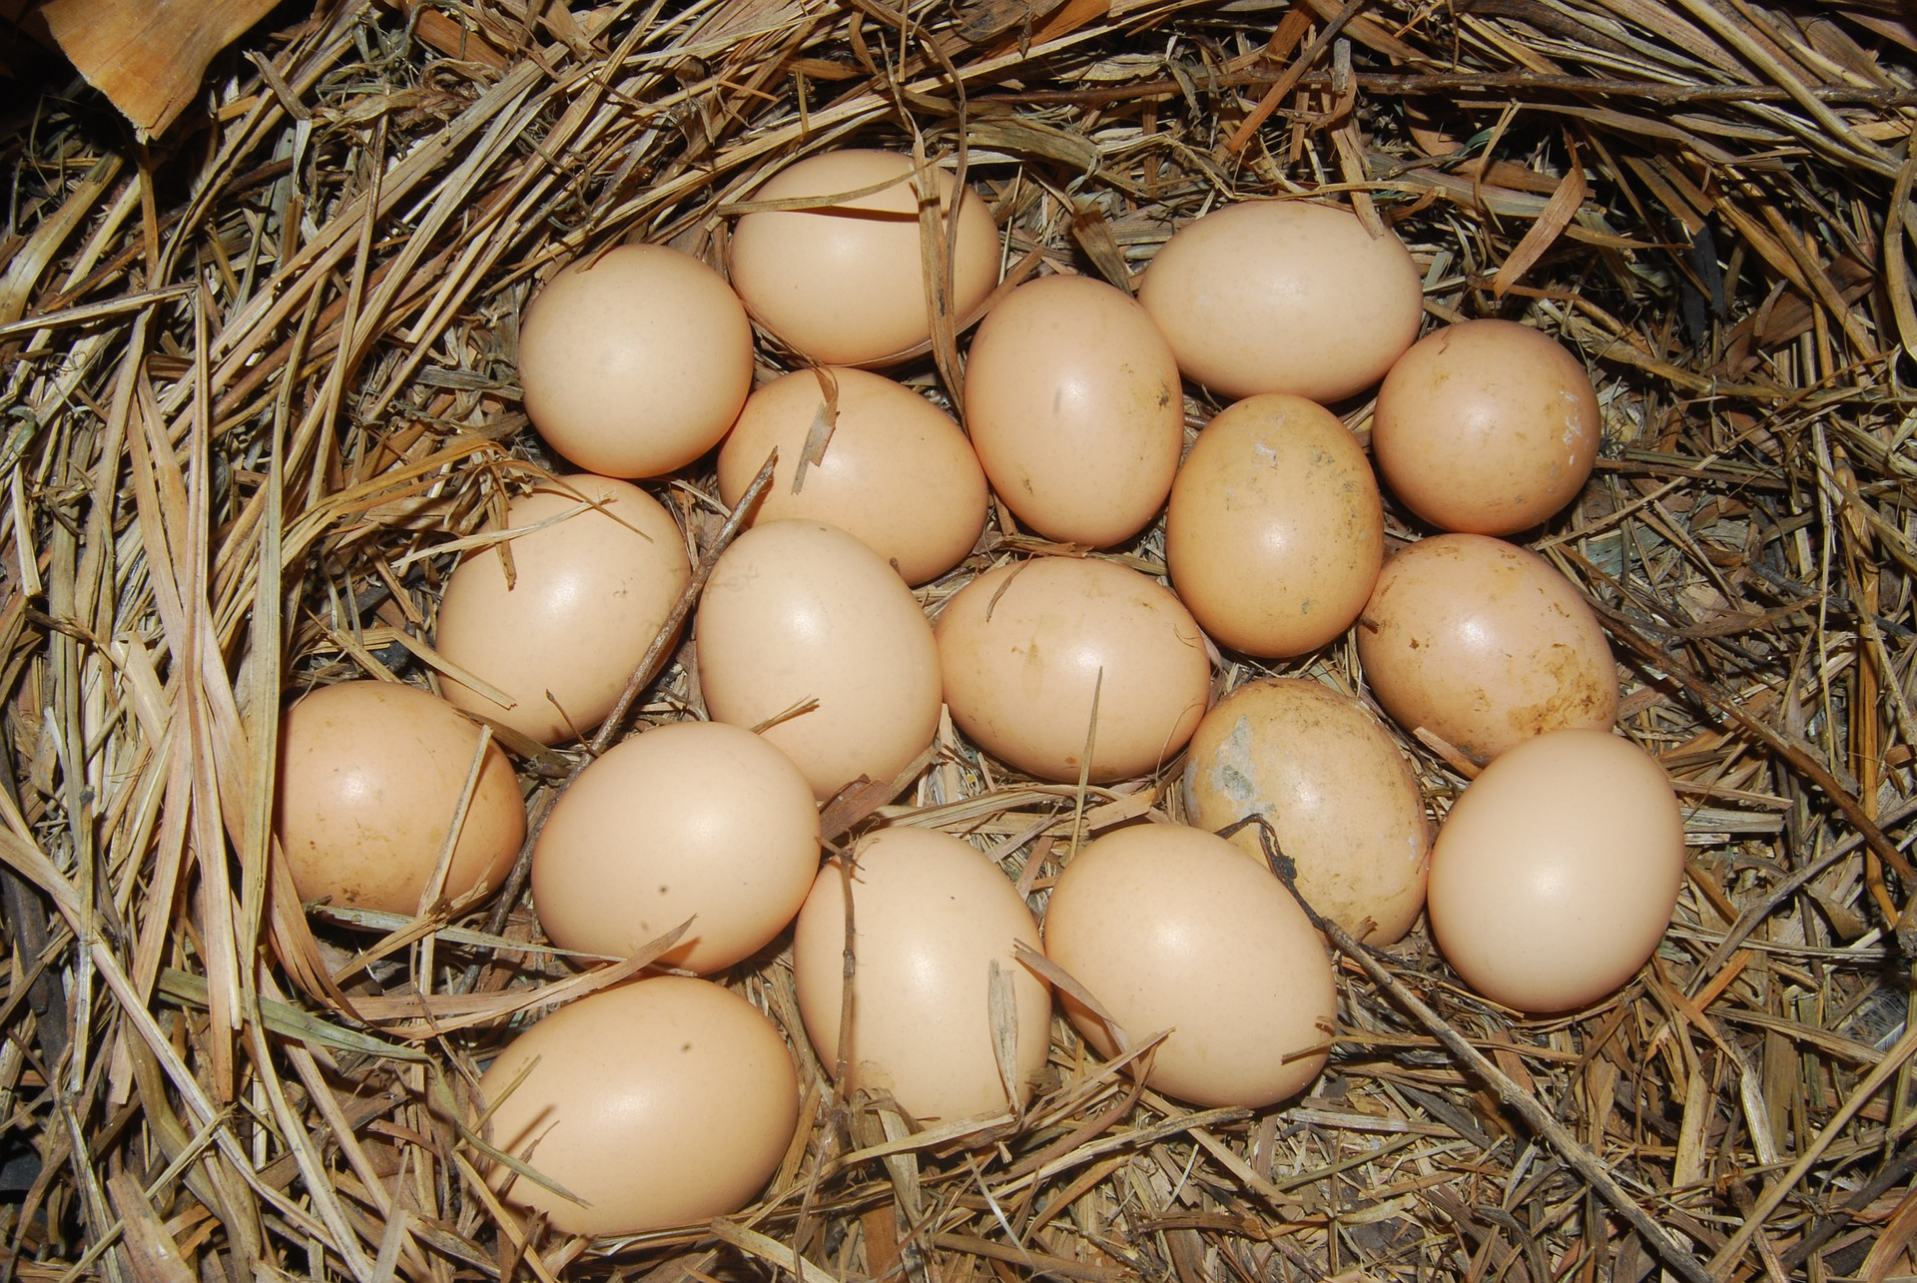
Nests

Slide 4
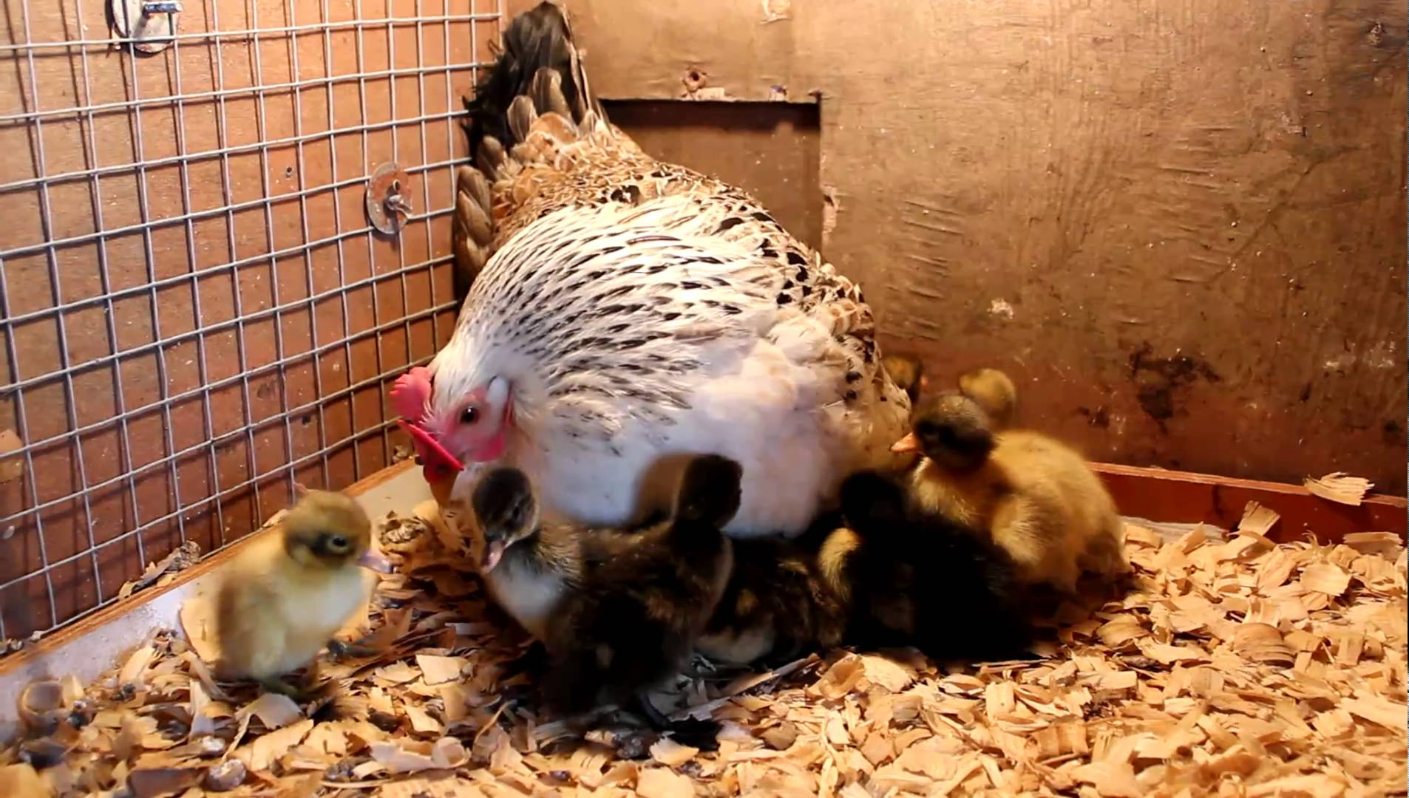
Management of hens
Take care all the chicks

Slide 5
Artificial Methods of Incubation Artificial Methods of Incubation
Artificial Methods of Incubation
Hot air Incubator
Artificial Methods of Incubation
Artificial Methods of Incubation
Heat regulation
Hot air Mammoths
Hot water incubator

Slide 6
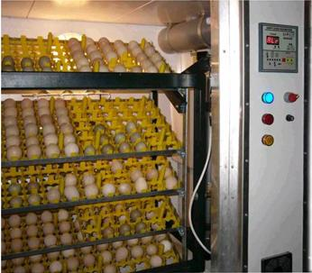
Artificial Methods of Incubation

Slide 8
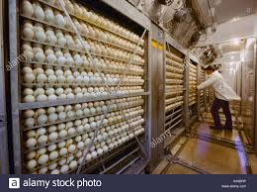

Slide 9
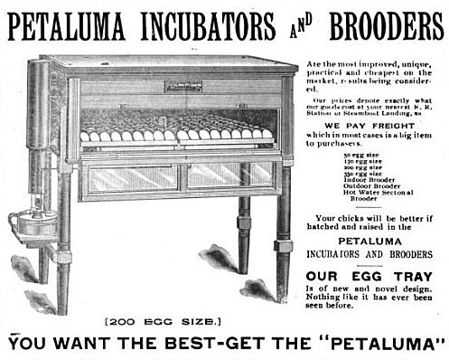

Slide 10
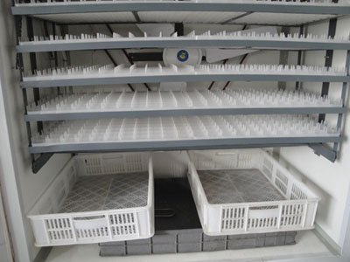

Slide 11
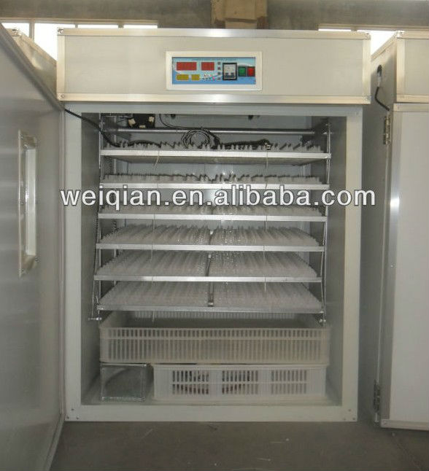

Slide 13
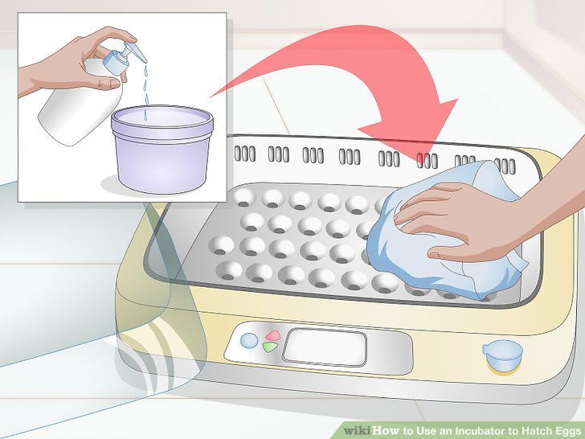

Slide 14
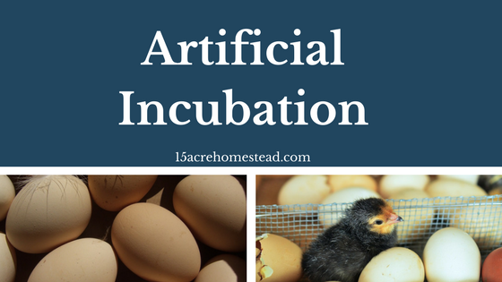

Slide 15
Precautions during incubation
1.Fumigation
2.Levelling
3.Trial run
4.Orientation of eggs
5.Temperature
6.Ventilation
7.Turning eggs

